Slide 1
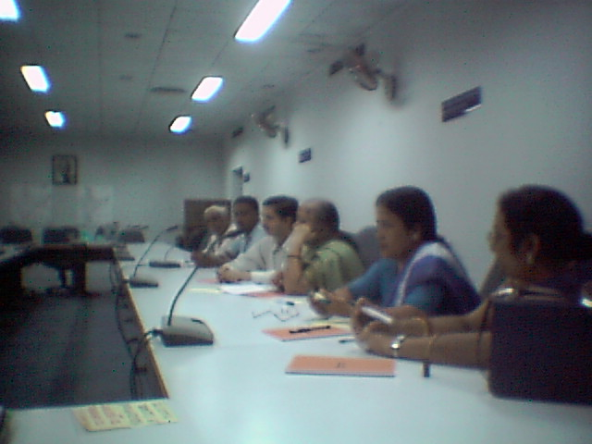
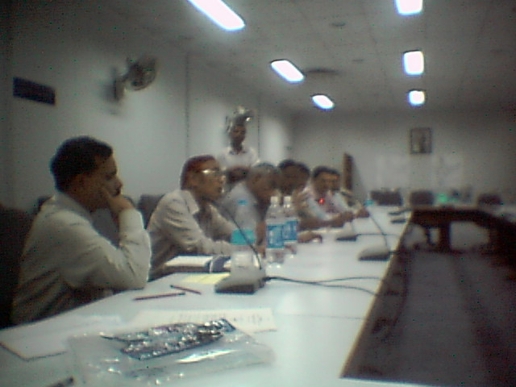
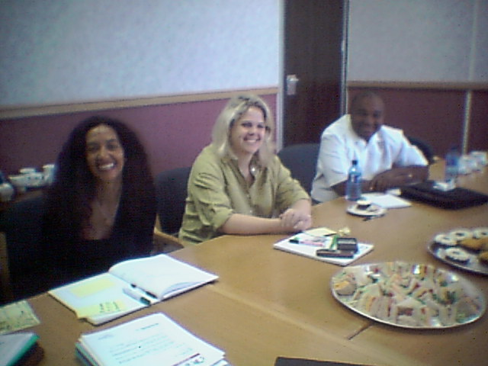
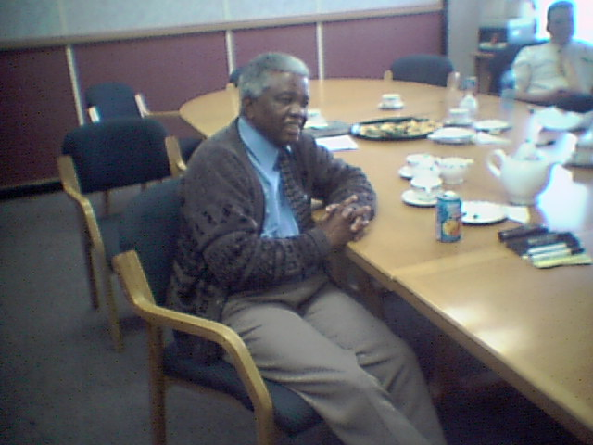
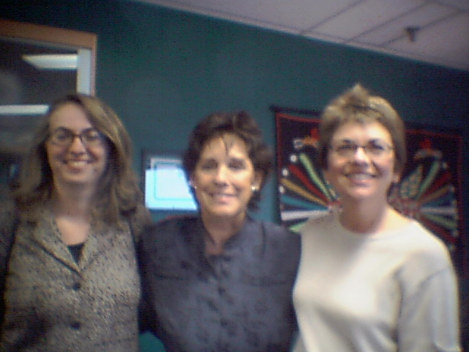
WRTVC INTERNATIONAL GUIDELINES
INTEGRATED QUALITY MANAGEMENT SYSTEM
Requirements for
Radio, TV and Internet Broadcasters
Montreal
21, 22 November 2002
isas@isasgroup.com
Guillaume.Cheneviere@tsr.ch
Gmorand@rezonance.ch

Slide 2
The ISO 9000:2000 requirements
EXPECTED QUALITY
by the Customer
PLANNED
QUALITY
by the Company
Measurement of the
Client’s satisfaction
Measurement of the
Performance of the Company
PERCEIVED
QUALITY
by the Customer
PRODUCED QUALITY
by the Company

Slide 3

The 8 principles of TQM …
Customer focus
Leadership
Empowerment
Process approach
Systemic approach
Continuous improvement
Decisions based on facts
Relationship with suppliers mutually beneficiary

Slide 4

The 8 principles of TQM …
Transition towards TQM
Quality Control Quality Management
Past Future
Detect faults Prevent errors
Look for guilty persons Look for defaults in the processes
Accuse Help, Moderate, Facilitate
Punish Motivate
Micro-management Systematic and systemic management
Notes:
Notes personnelles :

Slide 5
The 8 principles of TQM …
Empowerment?
VOICE OF THE
CUSTOMER
VOICE OF THE
MANAGEMENT
VOICE OF
THE PERSONNEL
VOICE OF
THE SOCIETY

Slide 6
The 8 principles of TQM …
Continuous improvement ?
Deming’s wheel
(P.D.C.A.)
PLAN
DO
ACT
CHECK
Continuous
Improvement
ISO
9000

Slide 7
The ISO 9000:2000 requirements
5 sections of requirements to translate in practice
The 8 principles of TQM
4- QUALITY MANAGEMENT SYSTEMS
(QMS, documentation requirements)
5- MANAGEMENT RESPONSIBILITY
(Management commitment, Customer focus, Quality Policy, Planning, Responsibility, Authority and Communication, Management Review)
6- RESOURCE MANAGEMENT
(Provision of Resources, Human Resources, Infrastructure, Work Environment)
7- PRODUCT REALIZATION
(Planning, Customer Related Processes, Design and Development), Purchasing, Service Provision, Control of Measuring Devices)
8- MEASUREMENT, ANALYSIS AND IMPROVEMENT
(Monitoring and Measurement, Control of Non-conforming Product, Analysis of Data, Improvement)

Slide 8
Systemic approach ?
The 8 principles of TQM …
Continuous improvement of the
Quality Management System
CLIENT
Management
Responsibility
CLIENT
Resource
Management
Measurement,
Analysis and
Improvement
Satisfaction
Requirements
Product /
Service
Realization
Input
Data
Output
Data
Product
Service

Slide 9
Presentation of ISO 9000:2000
“A COHERENT PAIR”:
  ISO 9001:2000 – Quality Management Systems: REQUIREMENTS (WHAT ?)
  ISO 9001 oriented effectiveness and certification,
  ISO 9004:2000 - Quality Management Systems: GUIDELINES FOR PERFORMANCE IMPROVEMENTS
  (HOW ...?)
ISO 9004 oriented effectiveness and efficiency

Slide 10
Presentation of ISO 9000:2000
TWO OTHER PRIMARY NORMS:
  ISO 9000:2000 – Quality Management Systems: Fundamentals and vocabulary
  ISO 19011:200X – Guidelines for quality and/or environmental management systems auditing. This standard is at the draft stage (issuance expected Q3 2002) and will replace:
    ISO 10011-1:1990
    ISO 10011-2:1991
    ISO 10011-3:1991
    ISO 14010:1996
    ISO 14011:1996
    ISO 14012:1996

Slide 11
Presentation of ISO 9000:2000
And two technical support documents:
  ISO 1000x – Technical brochure - Selection & Use
  ISO 1000y - Principles and application of quality management

Slide 12
The 9 criteria of the EFQM Model
Enablers
Results
Leadership
100 points
(10%)
People
90 points (9%)
Processes
140 points
(14%)
People Results
90 points (9%)
Key
Performance
Results
150 points
(15%)
Policy and Strategy
80 points (8%)
Customer
Results
200 points (20%)
Partnerships &
Resources
90 points (9%)
Society Results
60 points (6%)
Capacity 500 points (50%)
Results 500 points (50%)
The percentages were established following a wide ranging survey
to collect views
We acknowledge here the key role of leadership, policy and strategy,
the management of people and the management of partnerships
and ressources.

Slide 13
Self- Assessment Tool
Management system (sample)
Not At All /Never
Very Strong / Always
Strong / Often
Small / Sometimes
1- Have you defined in writing the Mission of your company?
2- Is it appropriately deployed in operational objectives and action plans?
3- Is there meetings between the personnel and the management on a regular basis?

Slide 14
Self- Assessment Tool
Quality system (sample)
Not At All /Never
Very Strong / Always
Strong / Often
Small / Sometimes
1- Are written procedures available?
2- Is there an internal quality audit system in place?
3- Are non-conformities formally recorded and corrected?

Slide 15
Self- Assessment Tool
Human Resources (sample)
Not At All /Never
Very Strong / Always
Strong / Often
Small / Sometimes
1- Is there job descriptions in place for all the personnel?
2- Is there a formal system in place for the yearly evaluation of performance?
3- Is the training of the personnel well adapted to the needs?

Slide 16
Self- Assessment Tool
Customer focus (sample)
Not At All /Never
Very Strong / Always
Strong / Often
Small / Sometimes
1- Are you formally “listening”the voice of your customers on a regular basis?
2- Is there a system in place for the treatment of the complaints of your customers?
3- Do you measure the level of satisfaction of your customers?

Slide 17

Headlines of the future WRTVC Standard compatible with ISO 9001:2000 ...
  4- INTEGRATED QUALITY MANAGEMENT SYSTEM
  4-1- General requirements
  4-2- Documentation requirements
  4-2-1- General
  4-2-2- Integrated Quality Management Manual
  4-2-3- Control of documents
  4-2-4- Control of Records

Slide 18
Headlines of the future WRTVC Standard compatible with ISO 9001:2000 ...
  5- MANAGEMENT RESPONSIBILITY
  5-1- Management commitment
        5-2- Stakeholder focus
        5-3- Ethics & Policies
        5-4- Planning
        5-5- Responsibility, Authority and Communication
        5-6- Management review
        5-7- Vision, Values and Mission
        5-8- Independence, Transparency & Pluralism
        5-9- Corporate social investment

Slide 19
Headlines of the future WRTVC Standard compatible with ISO 9001:2000 ...
  6- RESOURCE MANAGEMENT
  6-1- Provision of resources
  6-2- Human resources
  6-2-1- General
  6-2-2- Competence, awareness and training
  6-2-3- Independence of journalists & producers
  6-3- Infrastructure
  6-2-1- General
  6-2-2- Quality of equipment
  6-2-3- Accessibility to the Media
  6-4- Work environment

Slide 20
Headlines of the future WRTVC Standard compatible with ISO 9001:2000 ...
  7- PROGRAMME PRODUCTION
  7-1- Planning of programme production
  7-2- Stakeholder - related processes
  7-3- Innovation & Creation
  7-4- Purchasing
  7-5- Programme and service provision
  7-6- Control of monitoring and measuring devices
  7-7- Quality & diversity of contents
  7-8- Participation, interactivity & citizen empowerment
  7-9- Social relevance (including gender issues, religion, etc.)
  7-10- Education
  7-11- Minority representation and proximity
  7-12- World perspective

Slide 21
Headlines of the future WRTVC Standard compatible with ISO 9001:2000 ...
  8- MEASUREMENT, ANALYSIS AND IMPROVEMENT
  8-1- General
  8-2- Monitoring and measurement of audience satisfaction
  8-3- Control of nonconforming product
  8-4- Analysis of data
  8-5- Improvement

